Slide 1
SQL CAPSTONE PROJECT
Name : santhosh kumar ciliveru
ID : S7946

Slide 2
Business problem
The project seeks to analyze Amazon's sales data to gain insights into the factors influencing the sales performance of its branches. It aims to understand consumer behavior, market trends, and the effectiveness of strategies such as pricing, marketing, and the impact of external factors like seasonality and economic conditions.

Slide 3
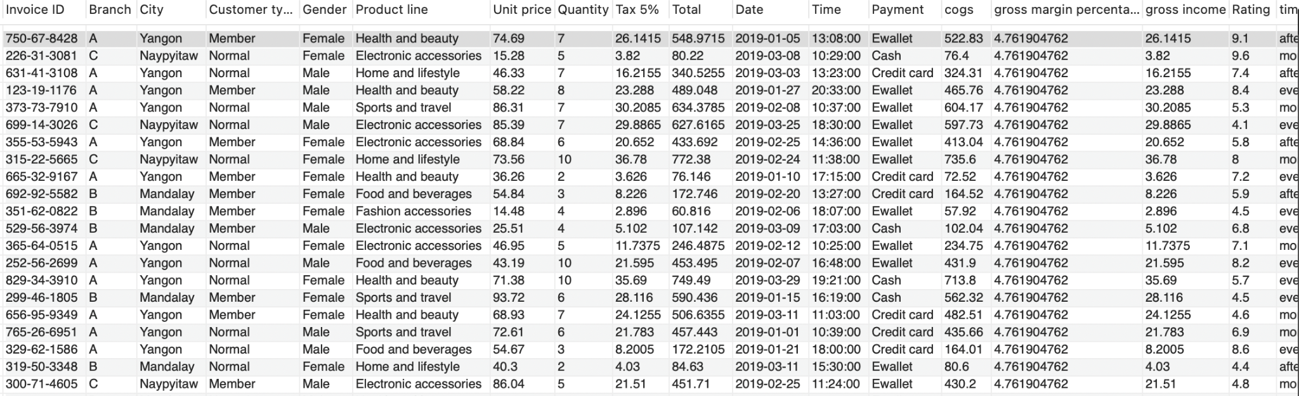
Data exploration

Slide 4
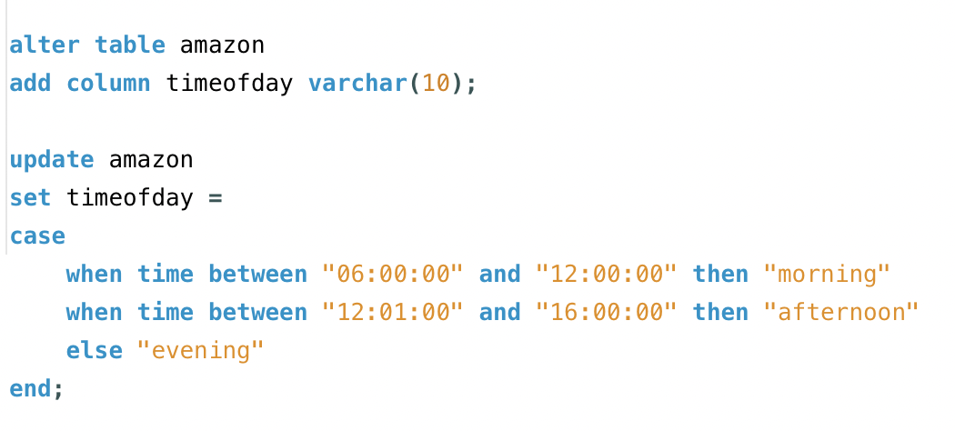
Feature engineering
1.By adding a "timeofday" column categorizing sales into Morning, Afternoon, and Evening, the analysis gains insights into peak purchase times, aiding in understanding consumer behavior and optimizing marketing strategies accordingly.

Slide 5
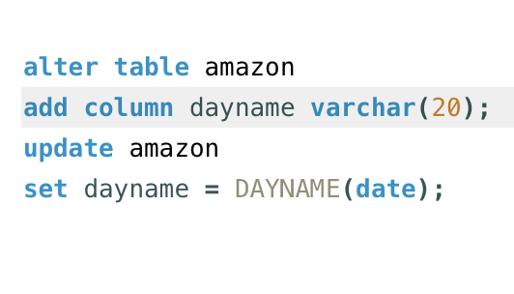
Feature engineering
2.Adding a "dayname" column extracts weekdays from transaction data, revealing busiest days for each branch, aiding scheduling and resource allocation.

Slide 6
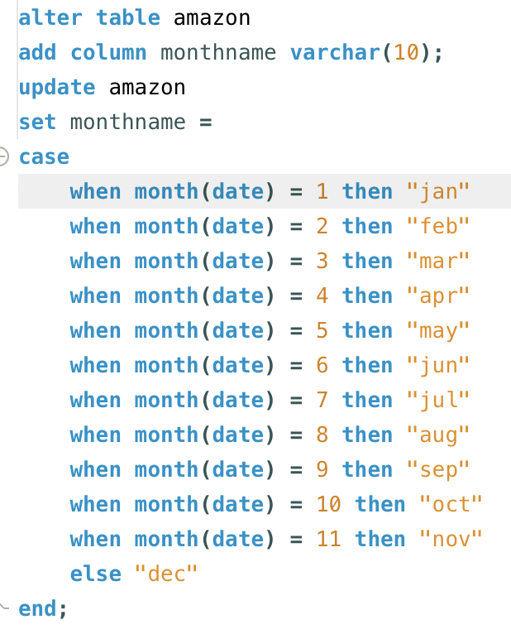
Feature engineering
3.By introducing a new column called "monthname," the analysis can extract the month of the year from transaction data, facilitating identification of the highest sales and profit months.

Slide 7
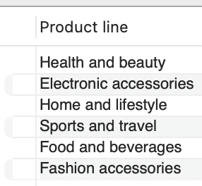
Product analysis
The product lines available in the dataset are:

Slide 8
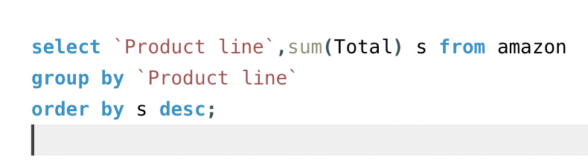
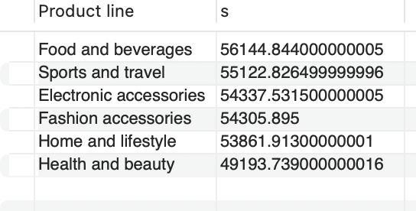
Product analysis
In comparison with the product lines
Food and beverages boast the highest sales figures.
Health and beauty products lag behind with the lowest sales.

Slide 9
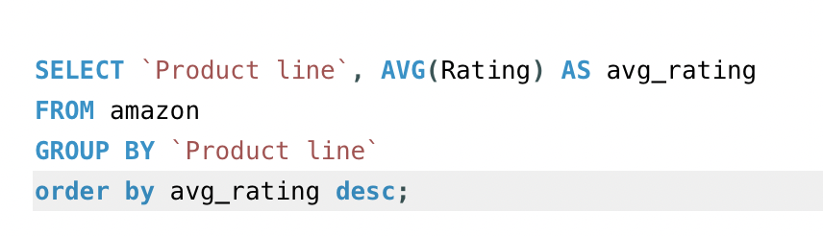
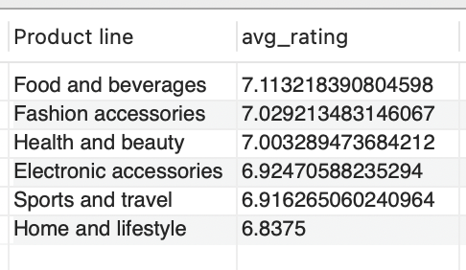
Product analysis
The average rating for the each product line:
Home and lifestyle items receive the lowest average rating.
Food and beverages garner the highest average rating.

Slide 10
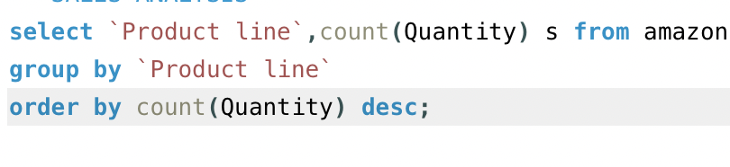
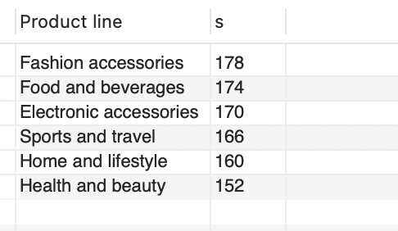
Sales analysis
The total quantity of products sold are:
Health and beauty products sold the lowest quantity (152 units).
Fashion accessories recorded the highest quantity sold (178 units).

Slide 11
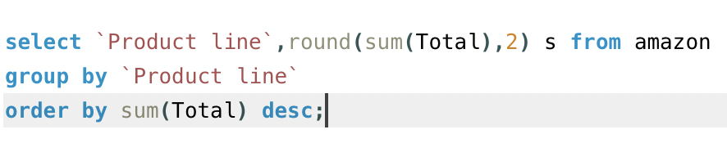
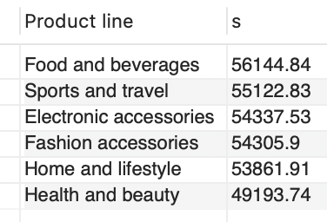
Sales analysis
In terms of the revenue, food and beverages generated the highest revenue whereas health and beauty generated the lowest revenue

Slide 12
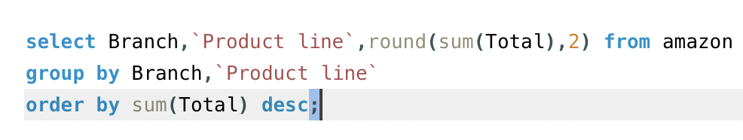
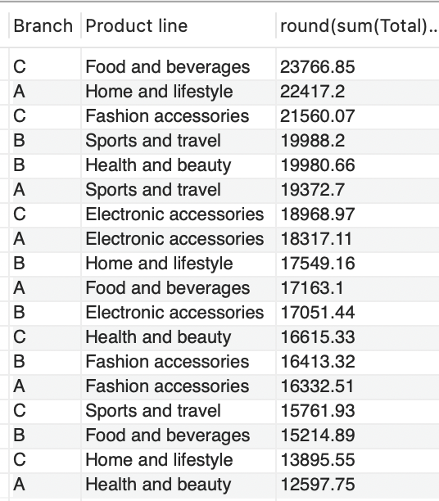
Sales analysis
Branch wise sales analysis with the
highest and lowest sales
BRANCH A = highest = home and lifestyle(22417)
BRANCH A = lowest = health and beauty (12597)
BRANCH B = highest = sports and travel(19988)
BRANCH B = lowest. = food and beverages(15214)
BRANCH C = highest = Food and beverages(23766)
BRANCH C = lowest = home and lifestyle (13895)

Slide 13
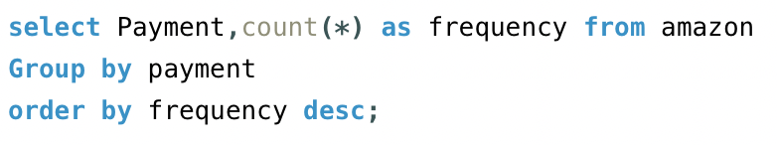
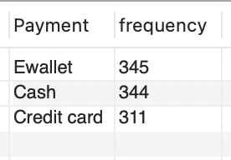
Sales analysis
The customers have used ewallet and cash as their payment options most of the time
We can improve credit card payment option by providing card offers for the customers

Slide 14
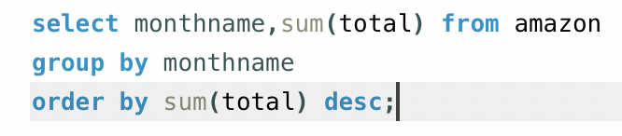
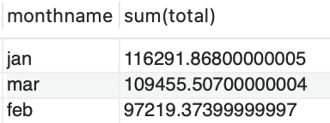
Sales analysis
February sales hit a low point, contrasting with January's peak sales performance during the first quarter.

Slide 15
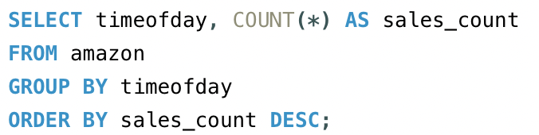
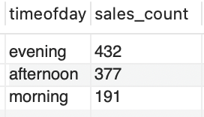
Sales analysis
The majority of product orders occur in the evening, with the lowest traffic observed during morning hours.

Slide 16
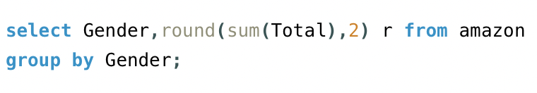
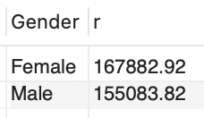
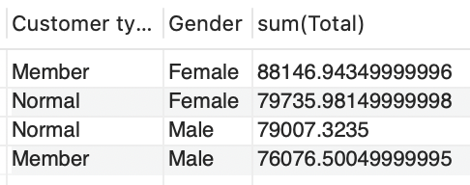
Customer analysis
Female customers, encompassing both members and regular users, have yielded higher revenue in contrast to male customers.

Slide 17
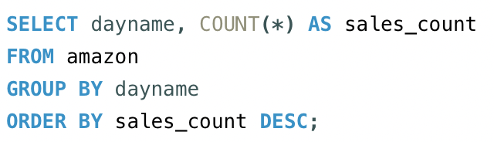
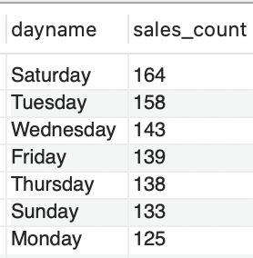
Customer analysis
Saturday and Tuesday witness the highest customer purchasing activity, contrasting with lower engagement levels on Sunday and Monday, indicating varied weekly trends in consumer behavior.

Slide 18
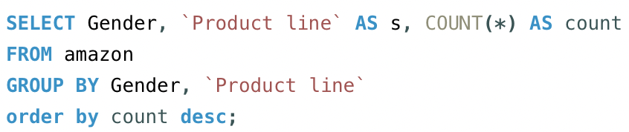
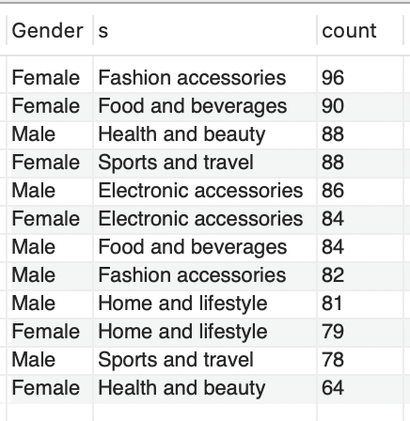
Customer analysis
Most purchases by females include fashion accessories, food and beverages, and sports and travel items, while their least purchased category is health and beauty products. For males, popular purchases are health and beauty products, electronic accessories, and food and beverages, with sports and travel items being their least purchased category.

Slide 19
Recommendations
Generate Buzz: Early bird offers create anticipation and excitement among customers. By offering special deals to those who purchase early, you can generate buzz around product and encourage people to buy sooner rather than later.
Partnership Opportunities: Collaborating with credit card companies to offer exclusive deals can be mutually beneficial. Credit card companies may be willing to promote your products to their cardholders, potentially increasing your customer base.
Personalised ads: Personalized ads are more relevant to the individual consumer because they are based on their demographics, interests, past behavior, and other data points. When an ad speaks directly to a person's needs or desires, they are more likely to pay attention and engage with it.

Slide 20
Conclusion
We've tackled various inquiries, from assessing product performance and sales trends to delving into customer behavior. These insights are vital for Amazon's sales strategies and can inform future optimizations.

